Slide 1


Slide 2


SHEDECIDES IS A
GLOBAL POLITICAL
MOVEMENT
DRIVING CHANGE,
FUELLED BY ACTIONS
IN COMMUNITIES,
WITH YOUNG PEOPLE
AT ITS HEART.
PURPOSE.
We enable courageous
collaboration driving progress
towards a world where every girl
and woman can decide what to do
with her body.
VISION.
A world where every girl and woman can decide what to do with her body, with her life and with her future. Without question.

Slide 3

The vision of the movement is the SheDecides manifesto - signed by every individual and organisation that decides to take action as a Friend or Champion of SheDecides. It is a powerful statement of the vision of the new normal that the movement aims for.

Slide 5


Slide 6
Working together, we will advance the fundamental right of girls and women everywhere to enjoy their bodies, make their own choices, and have access to comprehensive sexuality education and the full range of quality care that unite all parts of her sexual and reproductive life and health:
Privacy, sexuality, gender identity, choosing partners, pleasure, marriage, children – and integrated services covering contraception, pregnancy, abortion, infertility, STIs, HIV, cancers and violence.
This definition reflects the 2018 Guttmacher Lancet Commission report: Accelerate Progress—Sexual and Reproductive Health and Rights for All: report of the Guttmacher-Lancet Commission.

Slide 7
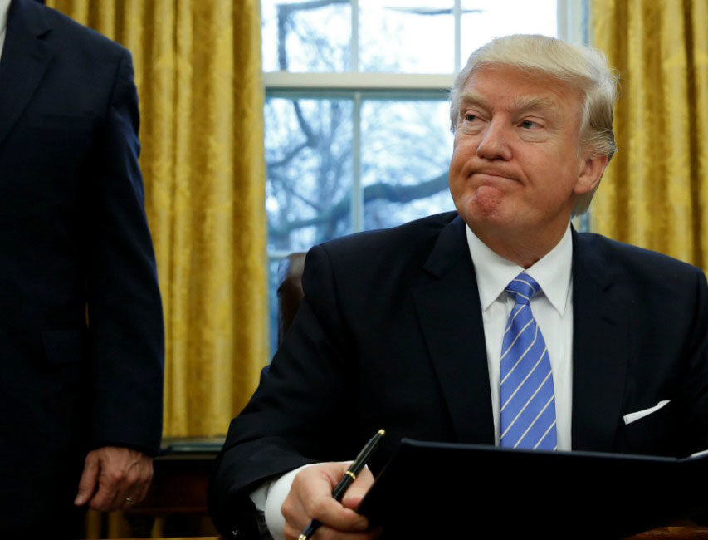

THE SPARK.
SheDecides was created in early 2017 as an immediate response to US President Donald Trump’s reinstatement and dramatic expansion of the Global Gag Rule to cover all $8.8 billion of US global health assistance. This policy which has devastating effects on women, girls and their communities around the world. The rule prevents NGOs outside the US from receiving money from the US government if they provide safe abortions or information about abortion.

Slide 8
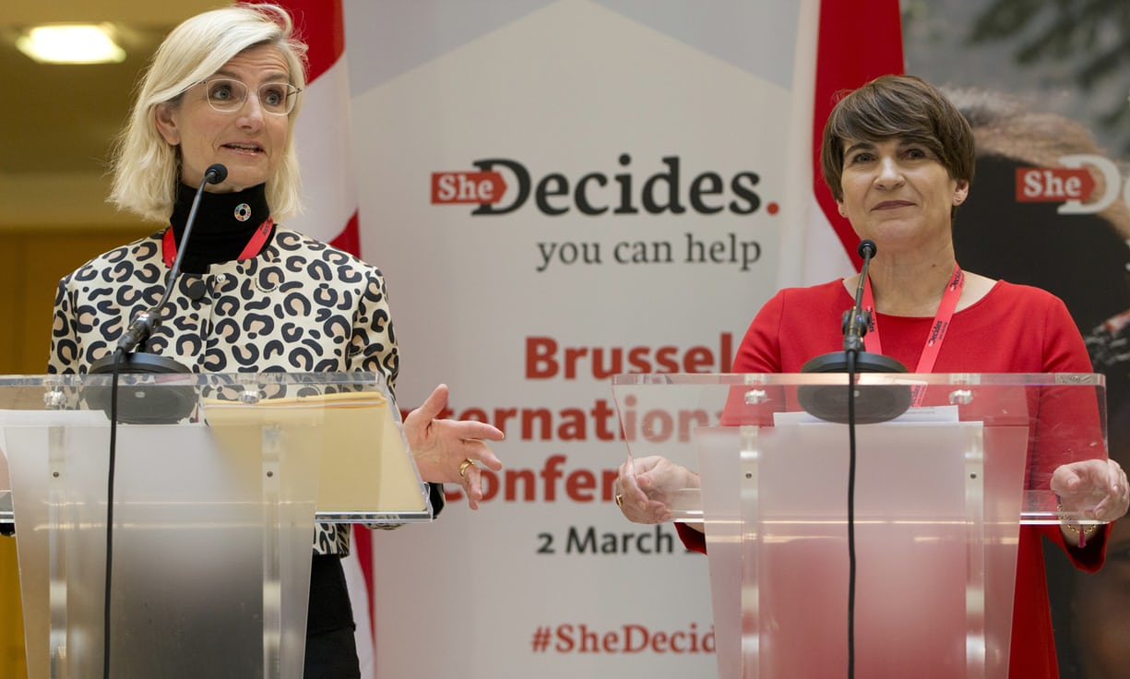

The movement connects people who have often not worked together before.
Political change works hand-in-hand with social change to create a “new normal.” Political change engages all parts of society – not only governments and parliamentarians.
SheDecides has rapidly evolved from two words, to a one-day conference into a global, political movement.

Slide 9
THE JOURNEY SO FAR…
THE JOURNEY SO FAR…
2 March 2017
12 July 2017
End December 2017
23 January 2017
Governments of Belgium, Denmark, Netherlands, Sweden host SheDecides conference with 50 governments, 450 people: approx. $200m pledged
SheDecides Manifesto launched at the Open House, London, the morning after the Family Planning Summit
US President Trump signs Executive Order reinstating and drastically expanding the Global Gag Rule
More than 40,000 Friends of SheDecides and 36 global Champions including Ministers, youth leaders, and others from all regions; $400m+ mobilised
24 January 2017
2 May 2017
17 September 2017
2 March 2018
Then Dutch Foreign Minister, Lilianne Ploumen Stands Up, Speaks Out says ‘She Decides’ – and puts money behind the words
SheDecides Support Unit opens based at CIFF [Children’s Investment Fund Foundation] London
First meeting of SheDecides Champions in New York City for UNGA72
First SheDecides Day and the launch of regional SheDecides movements.

Slide 10
3 GOALS OF THE STRATEGY
STAND UP, SPEAK OUT
CHANGE THE RULES
UNLOCK RESOURCES

Slide 11
1.
STAND UP.
SPEAK OUT.
Our goal is to change narratives in order to change norms that stand in the way of the freedom, rights and dignity of women and girls. Our manifesto, the vision of the movement, talks about these critical issues in a fresh, positive language that resonates with people all over the world. It counters the divisive ways people often speak about these issues, and oppress women and girls.

Slide 12
2.
CHANGE
THE RULES.
Our goal is to change laws, policies and procedures so that they actually support the freedom, rights and dignity of women and girls. To hold governments accountable for implementing them and respecting her rights to make the decisions that only she should make.

Slide 13
3.
UNLOCK
RESOURCES.
Our goal is to unlock the sustained, reliable resources necessary for women and girls all over the world to exercise all of their rights and access all of the services they need. We continue to call upon governments to meet their responsibilities to dedicate more resources for this work, at home and in other places, and to invest in the well-being of the women and girls they serve.

Slide 14

SHEDECIDES. AT LOCAL LEVEL.
Since the global movement emerged, it has become clear that as well as making big change globally, there needs to be a strong emphasis on achieving change where the agenda has most direct impact: at a local and regional level.

Slide 15

In many places, the energy behind the bold and ambitious vision of SheDecides is sparking national and regional movements that are starting to identify pressing policy changes and other transformative developments for their specific contexts.

Slide 16
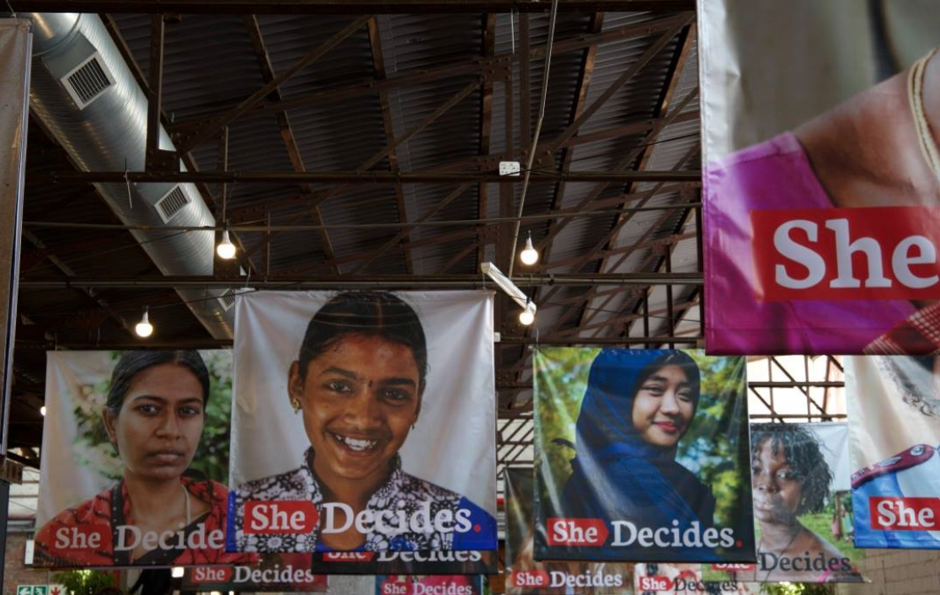
Strong and forceful local movements can make real change happen – shifting social norms; adapting laws, policies and procedures that block access to rights; holding governments to account for their promises; and unlocking resources for quality services.
Local movements are already emerging in India, Southern Africa, the Republique Democratique du Congo and Uganda. With more to come!

Slide 17
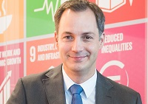
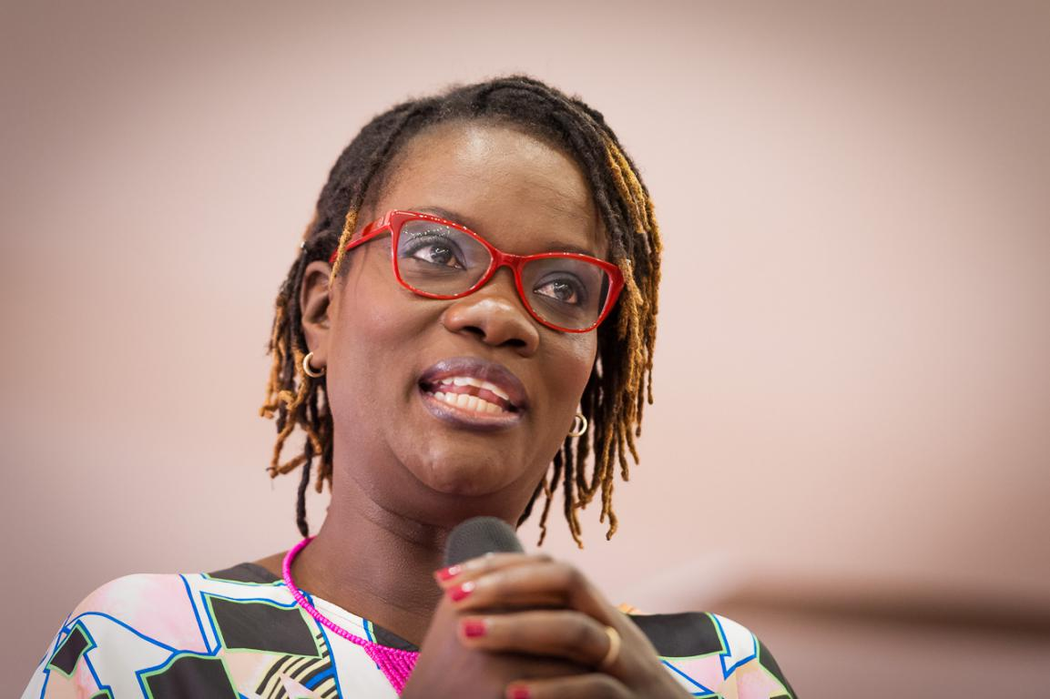

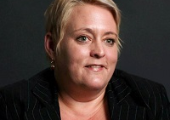
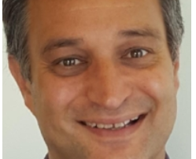
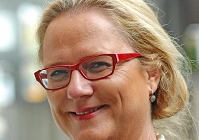
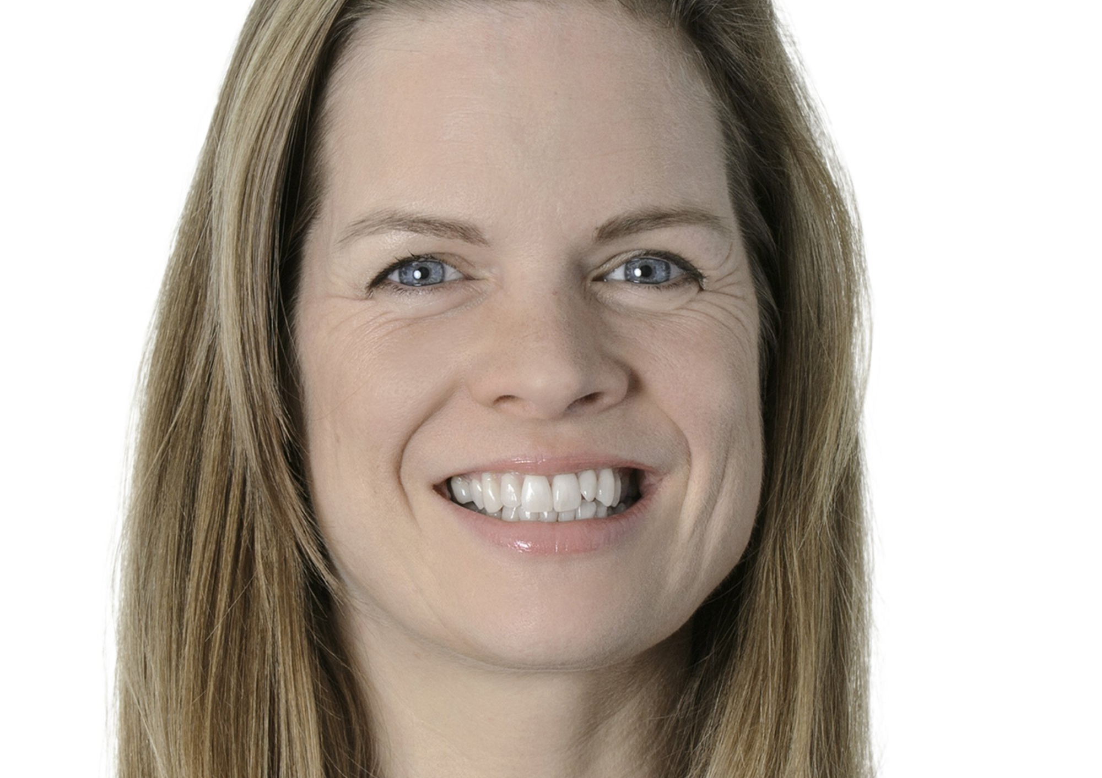

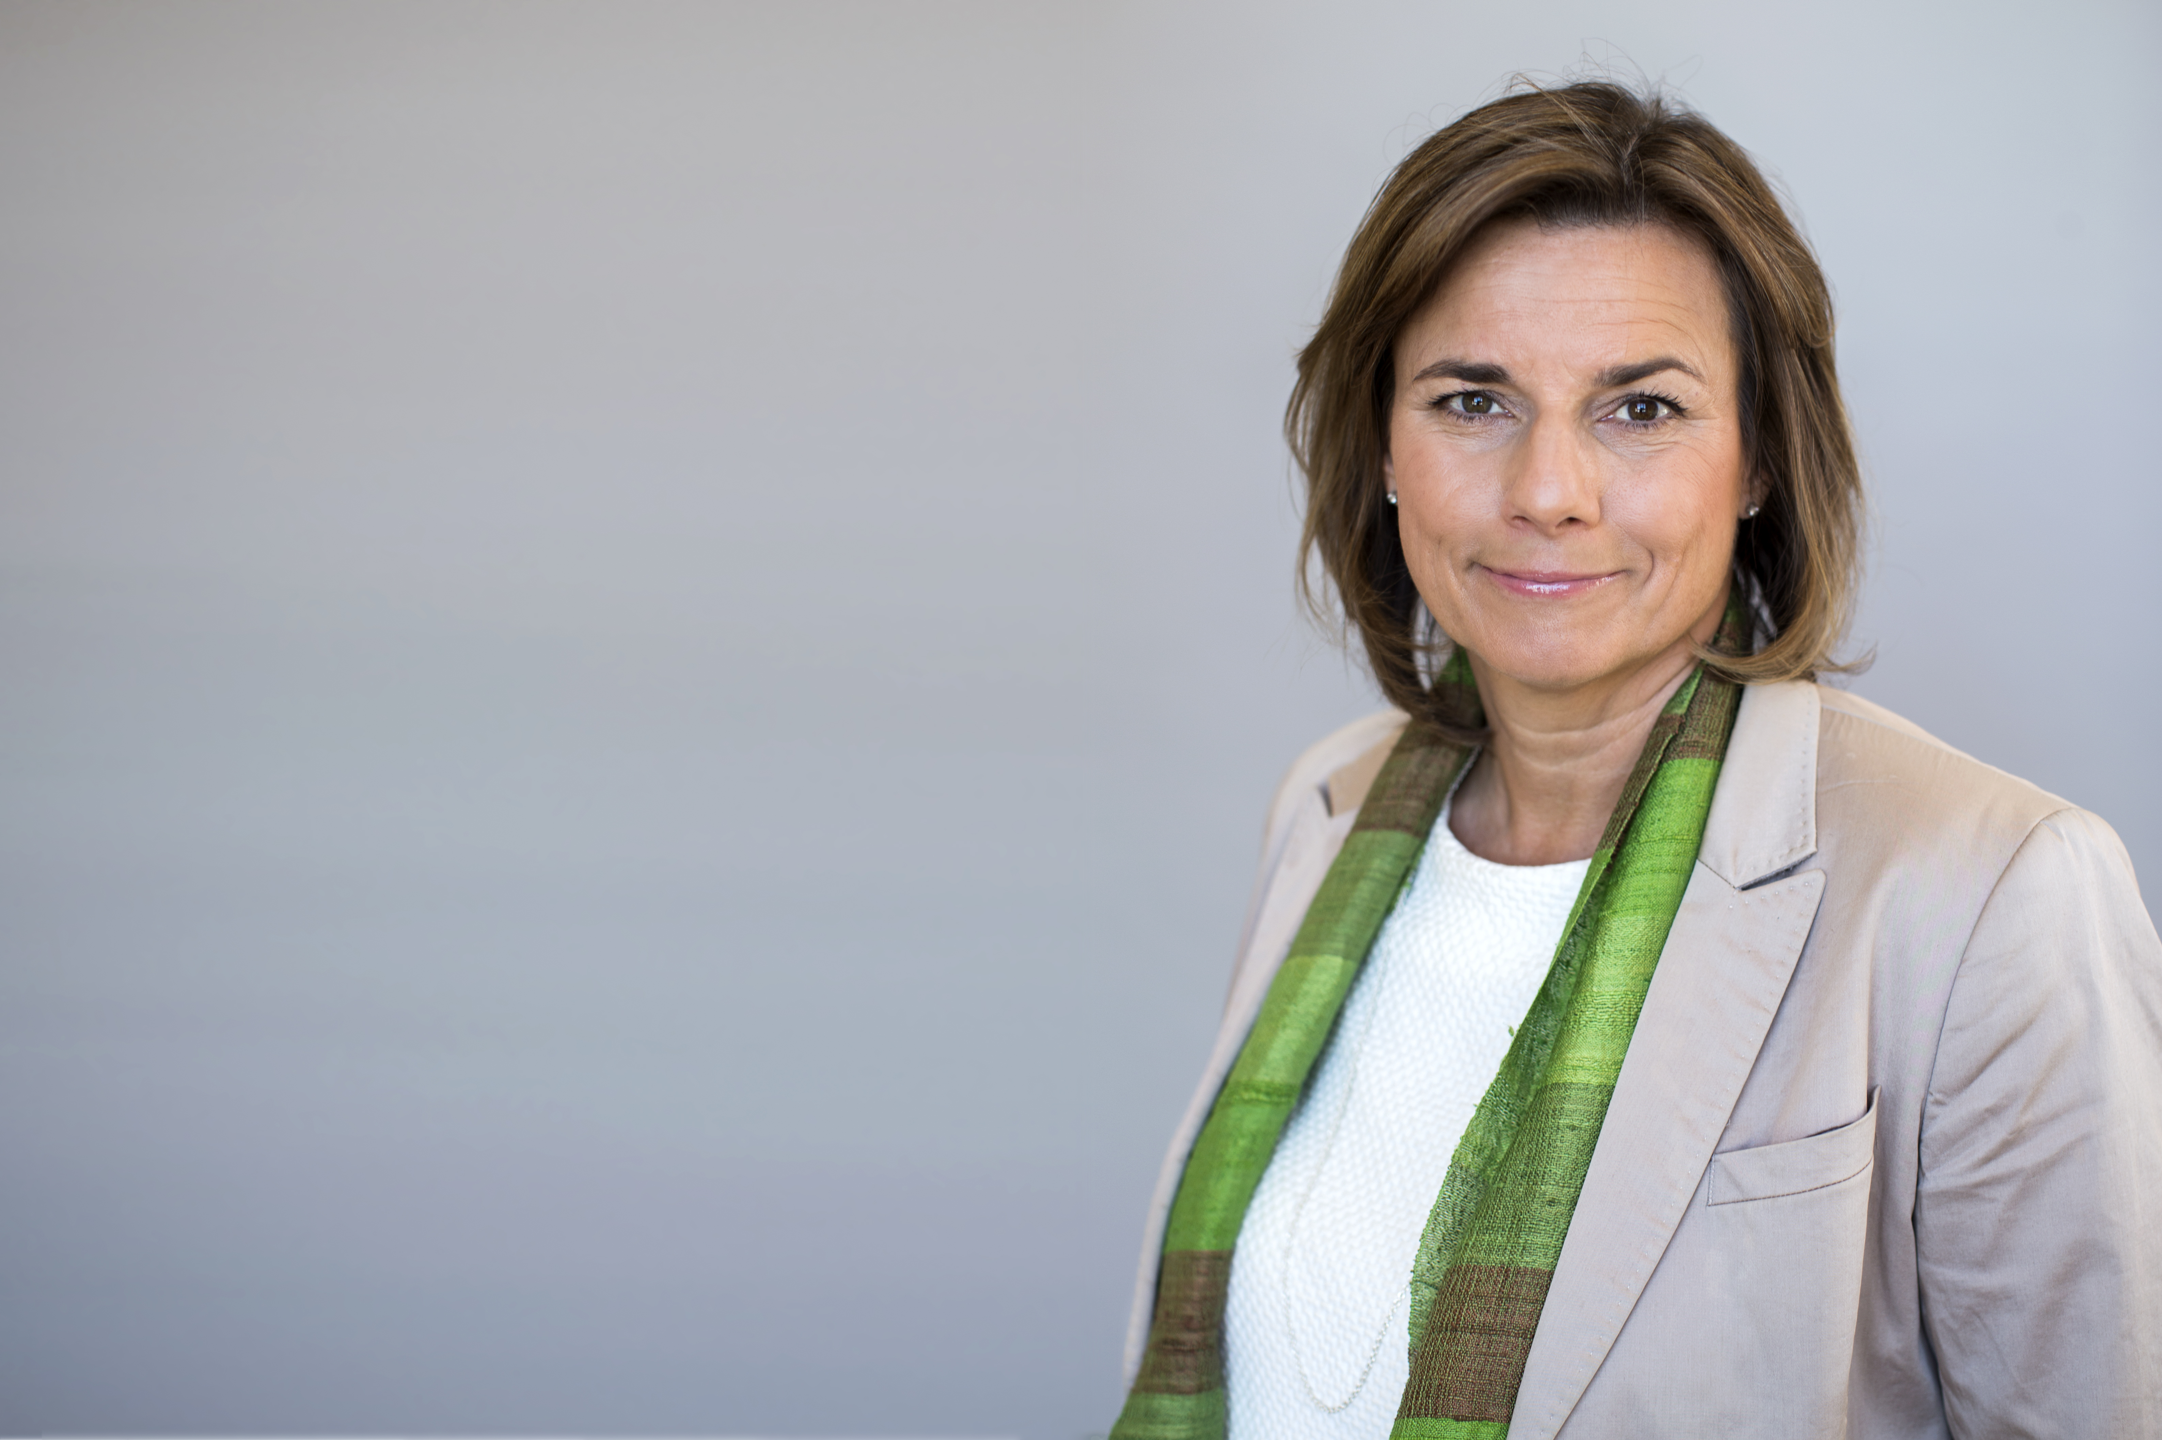

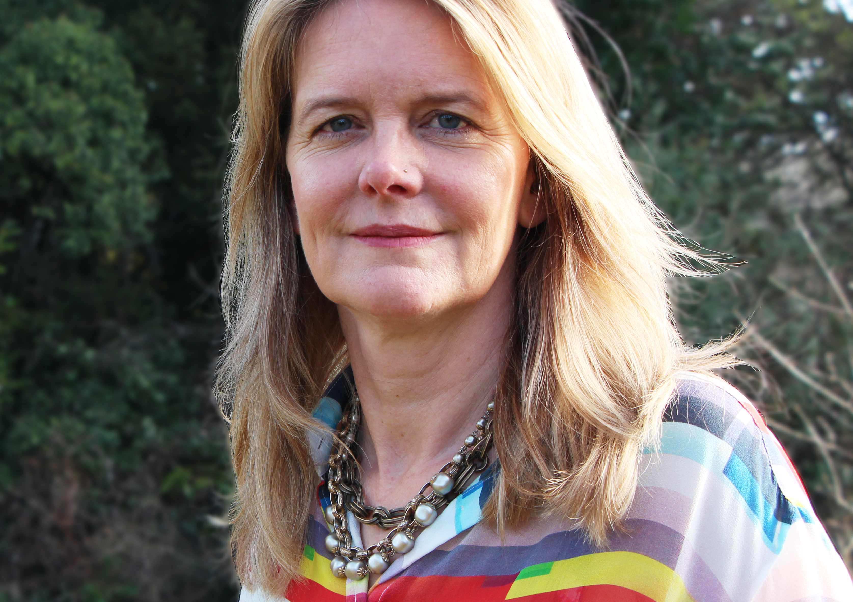
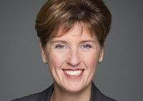
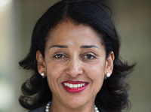
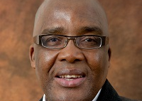
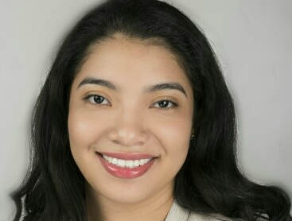
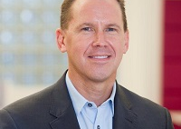
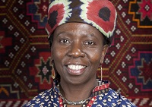
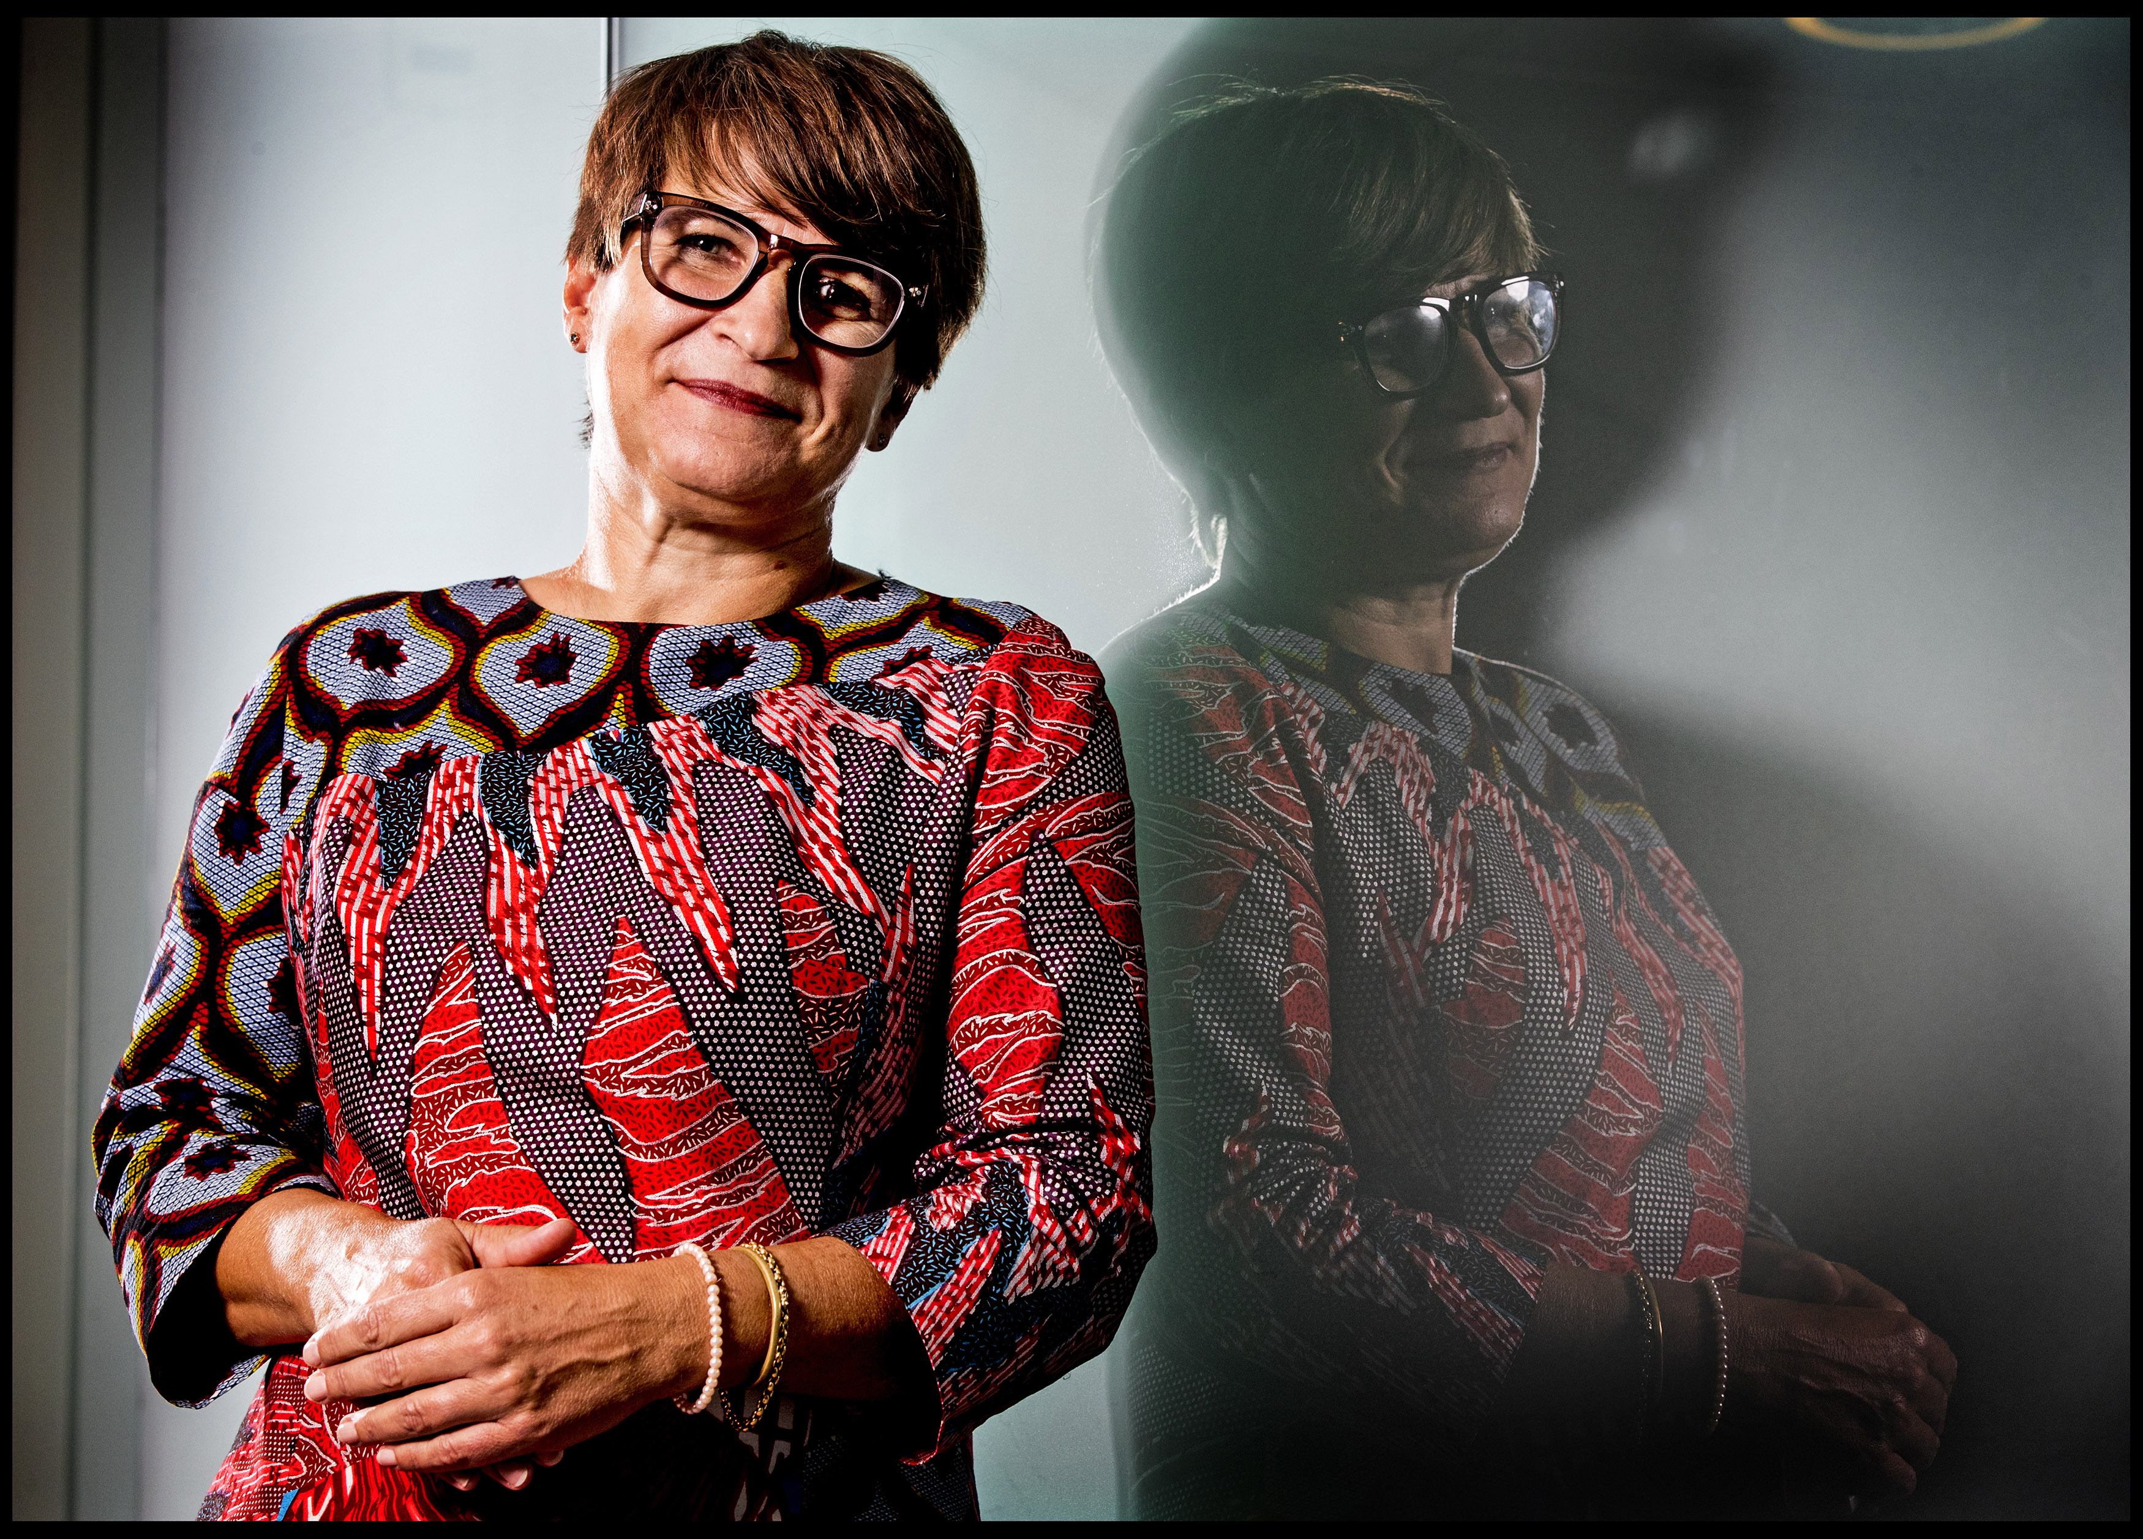
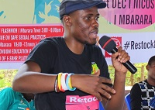
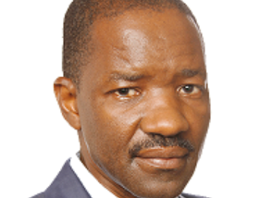
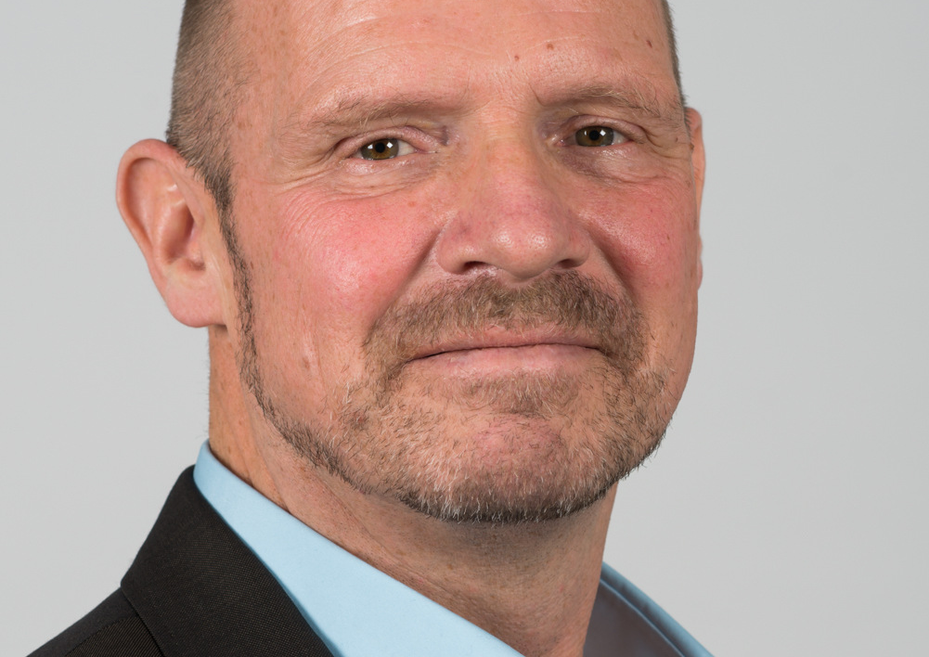
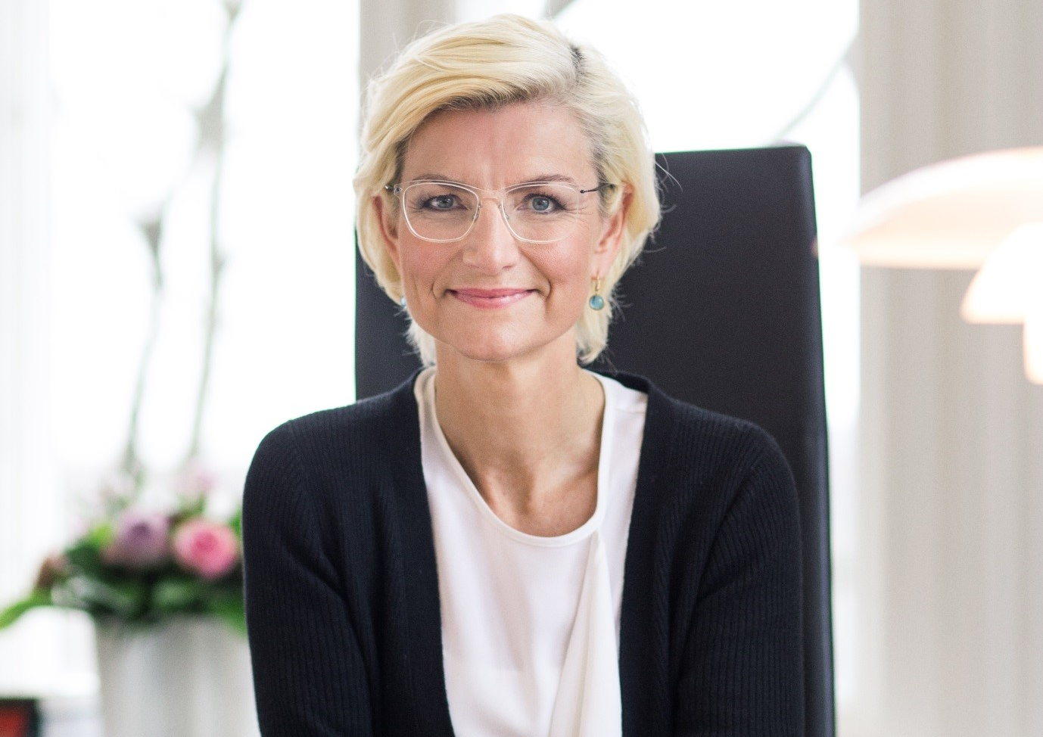
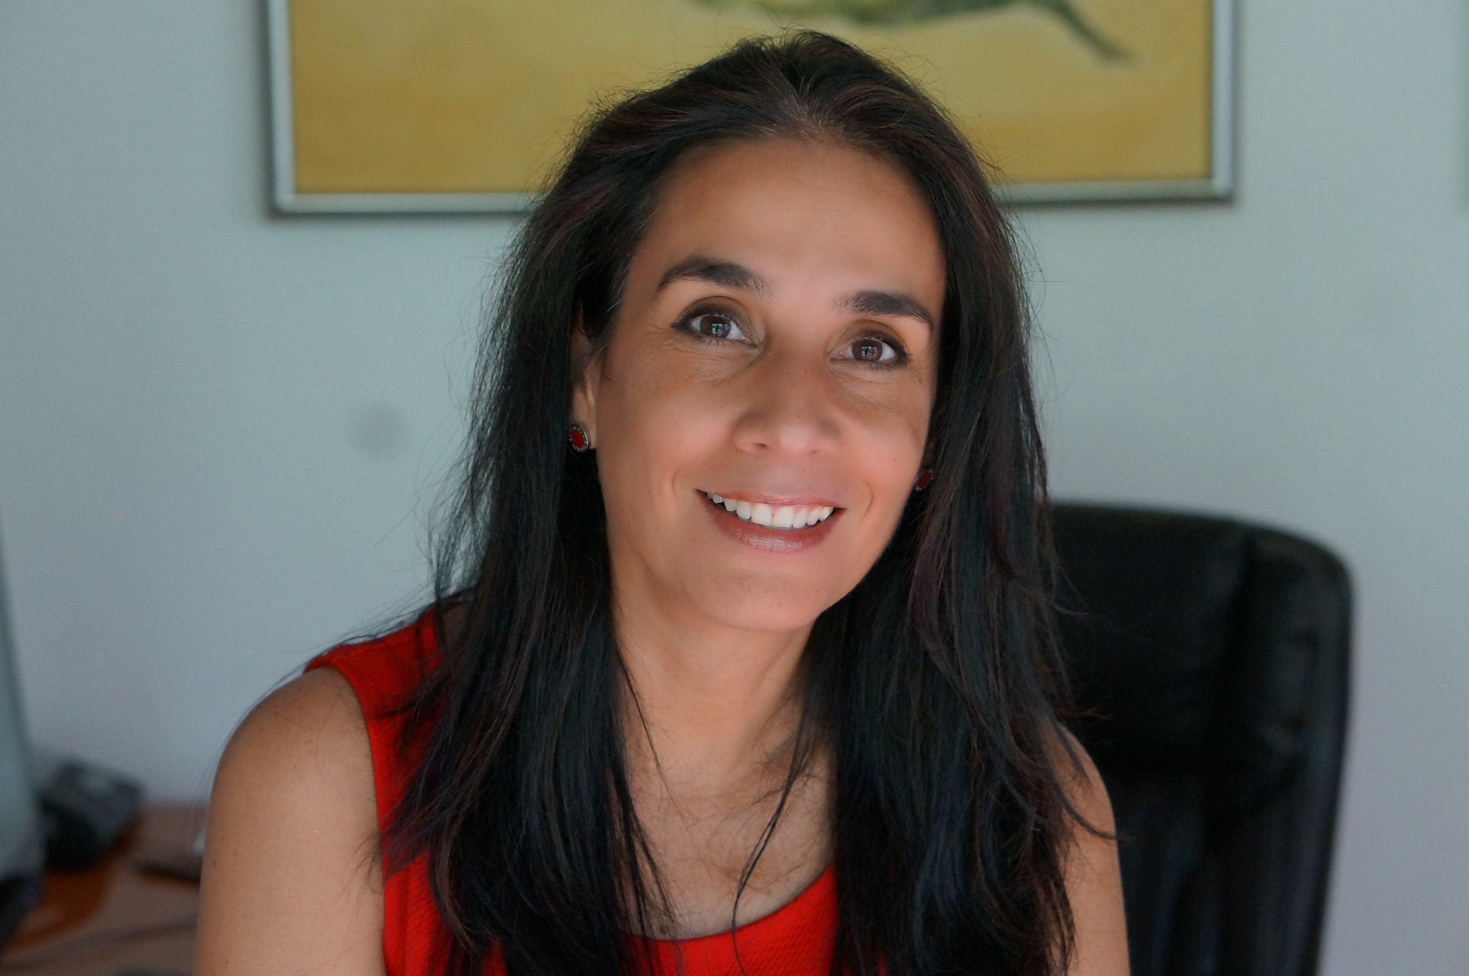
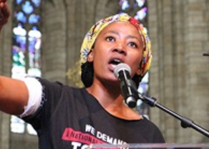
CHAMPIONS
Champions are the Ambassadors of the SheDecides movement. Many are Ministers and young leaders. They are individuals - some representing countries and organisations - who act alone and together to propel us toward a reality where every girl and every woman has power over her body.
Without question.

Slide 18

The SheDecides movement disrupts the power imbalances that for too long have stopped girls and women from deciding. Energized by evidence-based outrage, we are a conspiracy of hope.
Political leadership and social momentum are coming together like never before!
Sign the manifesto and join over 50,000 friends and 40 Champions of a world SheDecides. Without question.

Slide 19
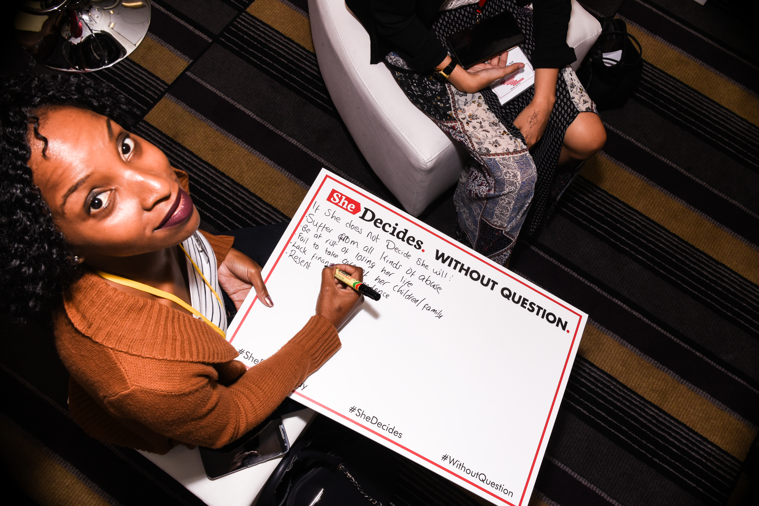
SIGN THE MANIFESTO.
SHEDECIDES.COM/THE-MANIFESTO/

Slide 20



THANK YOU!
www.facebook.com/SheDecidesGFI
twitter.com/shedecidesgfi
Email: info@shedecides.com
www.shedecides.com

